Slide 1

Introduction
Deep Learning in Earth Science v2 Lecture 1
By Xiao Zhuowei
10.11.2019

Slide 2
OUTLINES
OUTLINES
1
Goals of DLiES
2
Schedule
3
TensorFlow & Keras Basics
4
Discussions

Slide 3
Goals
Solve problems in field of Earth Science with Deep Learning.
Gain ability to develop deep learning programs can solve actual geophysical problems.
Gain ability to understand how deep learning methods work and propose novel algorithms to better solve geophysical problems.

Slide 4
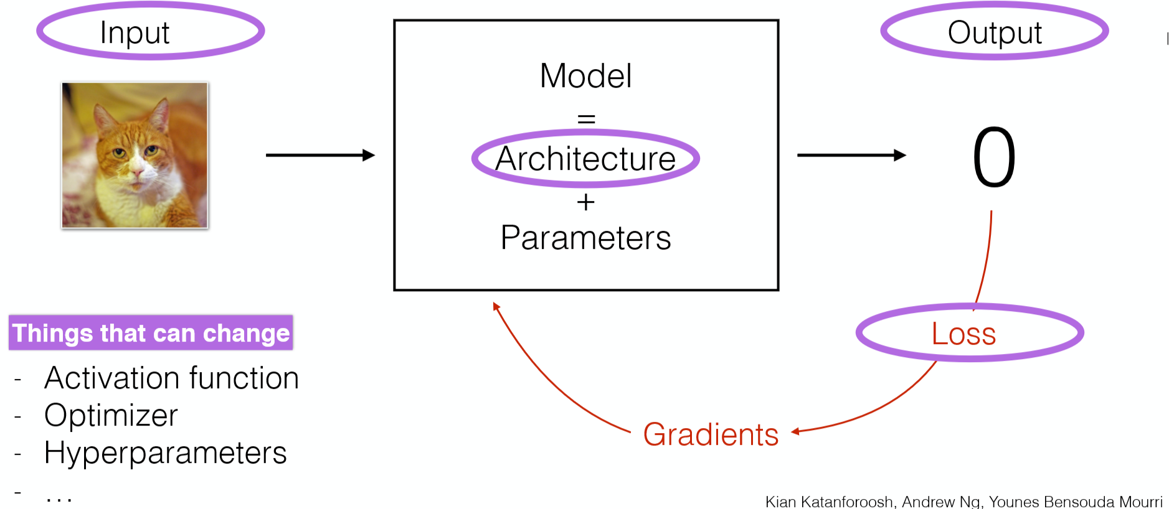
Goals
Image From Stanford CS230: Deep Learning

Slide 5
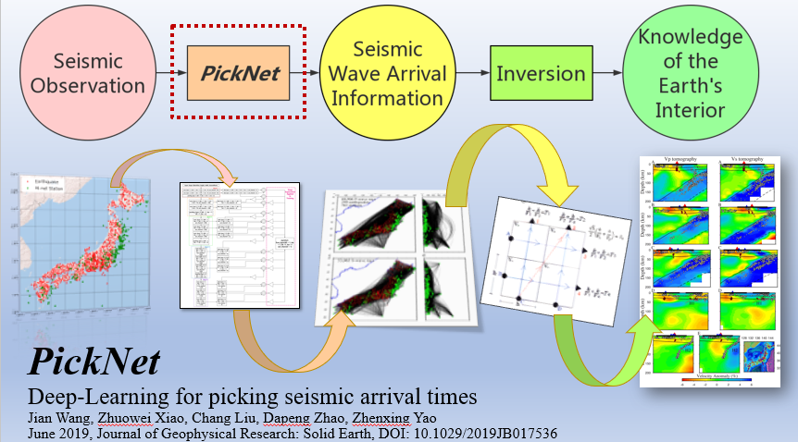
Goals

Slide 6
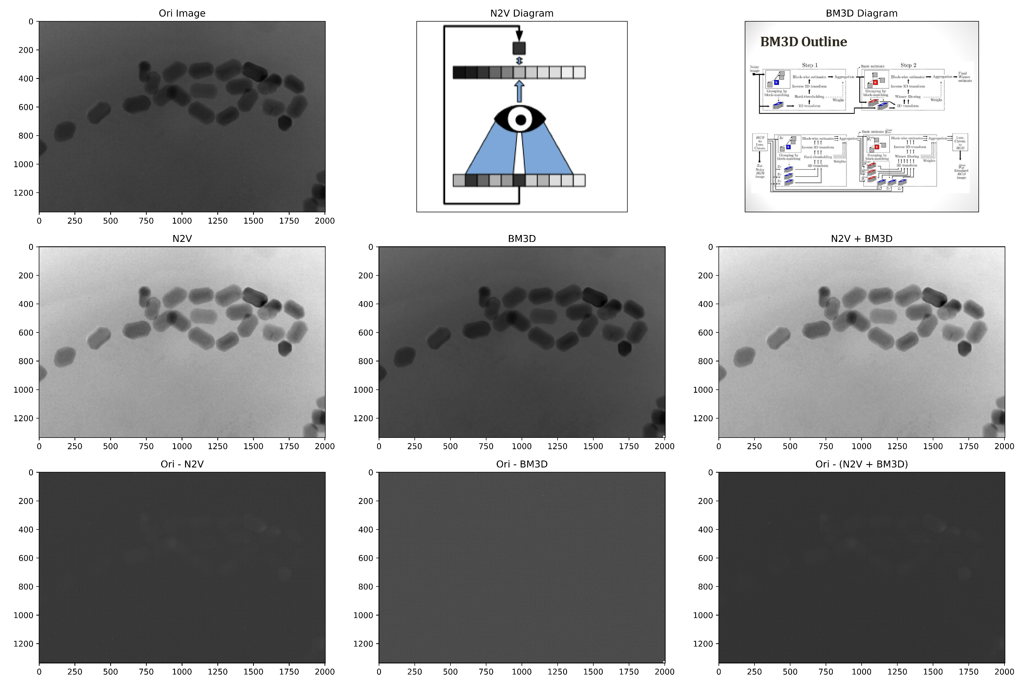
Goals

Slide 7
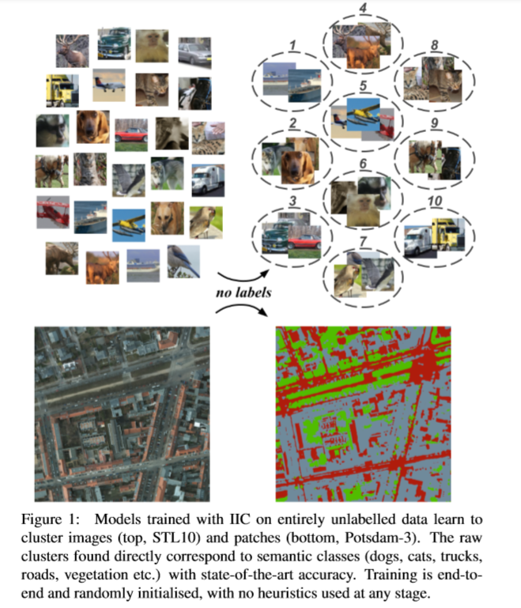
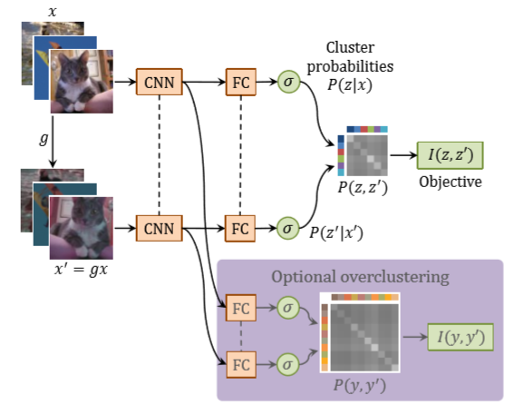
Goals
Ji et al., 2019, ICCV

Slide 8
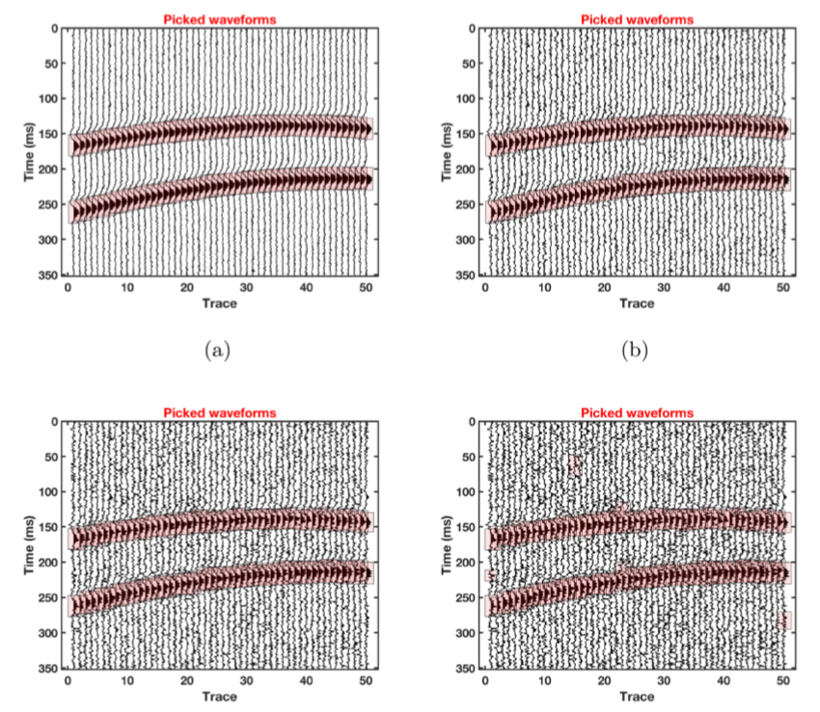
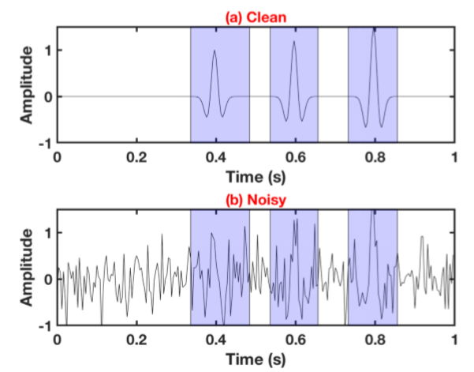
Goals
Chen., 2018, GJI

Slide 9
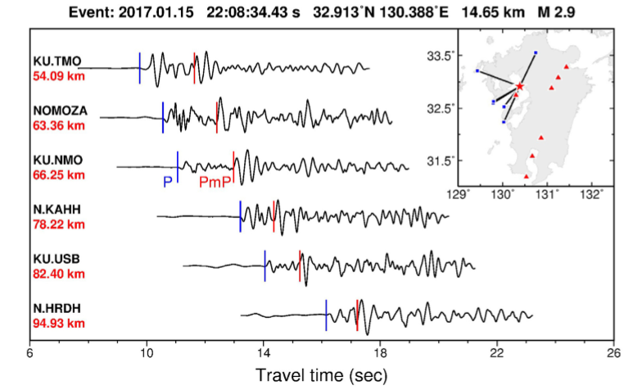
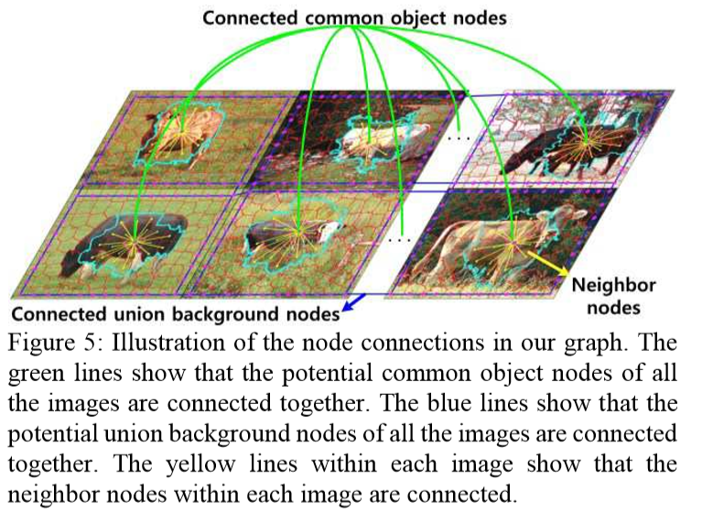
Goals
Quan et al., 2016, CVPR
Wang et al., 2018, GJI

Slide 10
OUTLINES
OUTLINES
1
Goals of DLiES
2
Schedule
3
TensorFlow & Keras Basics
4
Discussions

Slide 11
Schedule
Every Tuesday and Friday afternoon.
Tuesday—How to develop deep learning programs
Friday —Theories of deep learning

Slide 12

How to develop deep learning programs
We will be using Tensorflow library.
1. Use low-level API to build simple models
2. Use high-level API to build complex models
3. Develop custom loss functions,
optimizers, etc.
4. Develop programs solve real
geophysical problems.

Slide 13
Theories of deep learning
Information Theory
Graph Theory
Linear Algebra
Mathematical Optimization
…

Slide 14
Theories of deep learning
References:
Deep Learning with Python -Francois Chollet
深度学习实战 – 杨云 杜飞
Hands-on Machine Learning with Scikit-Learn, Keras & Tensorflow – Aurelien Geron

Slide 15
OUTLINES
OUTLINES
1
Goals of DLiES
2
Schedule
3
TensorFlow & Keras Basics
4
Discussions

Slide 16
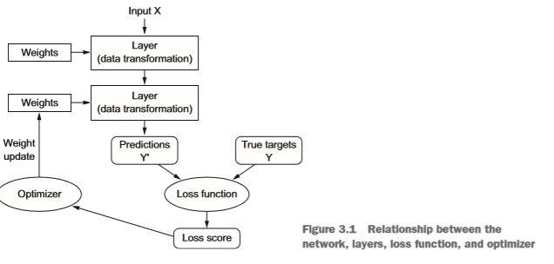
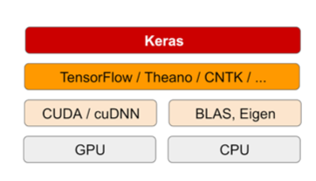
TensorFlow & Keras Basics
The deep-learning software and hardware stack
Anatomy of a Neural Network

Slide 17
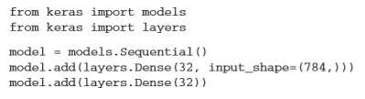
TensorFlow & Keras Basics
Layers

Slide 18
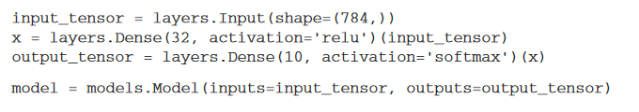
TensorFlow & Keras Basics
Build Model

Slide 19
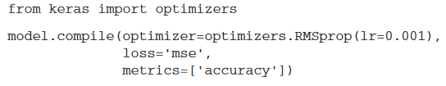
TensorFlow & Keras Basics
Compile Model

Slide 20
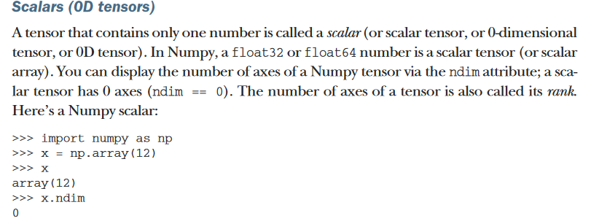
TensorFlow & Keras Basics

Slide 21
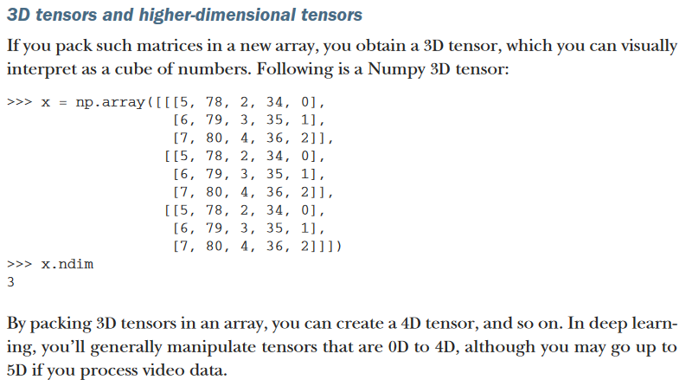
TensorFlow & Keras Basics

Slide 22
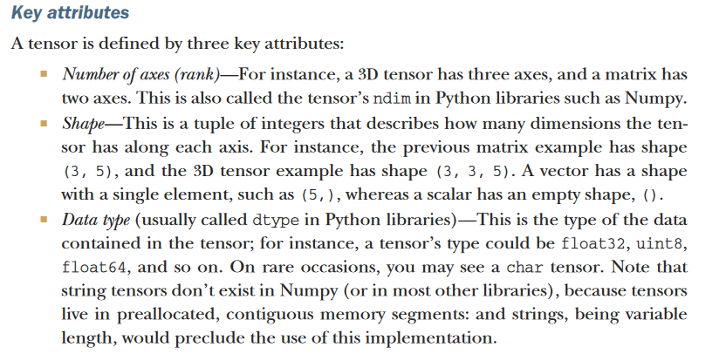
TensorFlow & Keras Basics

Slide 23
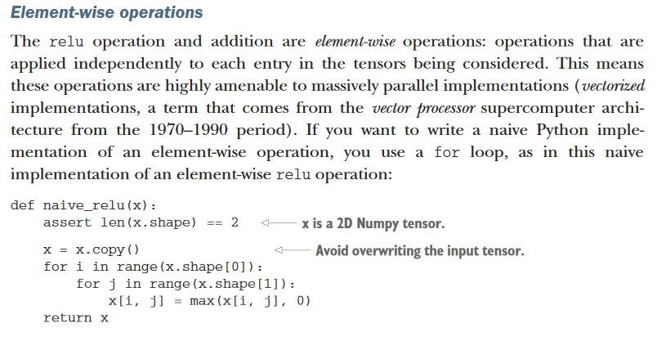
TensorFlow & Keras Basics

Slide 24
OUTLINES
OUTLINES
1
Goals of DLiES
2
Schedule
3
TensorFlow & Keras Basics
4
Discussions

Slide 25

Discussion

